Slide 1






Writing a CV
CV Structure, Content, Layout, Formatting, Best Practices
Teamwork and
Personal Skills
SoftUni Team
Technical Trainers
Software University
http://softuni.bg

Slide 2



Table of Contents
What Is a CV?
Why We Need a CV?
Why We Need a Good CV?
The Goal
Success Strategy
How to Stand Out?
Structure
Questions

Slide 3

What Is a CV?

Slide 4


What Is a CV?
Summary of skills and experience
Also known as "Resume" or "Curriculum Vitae"

Slide 5

What Is a CV?
Summary of skills and experience
Not a biography

Slide 6

What Is a CV?
Summary of skills and experience
Not a biography
Highlights accomplishments

Slide 7

Why We Need a CV?
Show experience

Slide 8

Why We Need a CV?
Show experience
Reflects more than paid work experience

Slide 9

Why We Need a CV?
Show experience
Reflects more than paid work experience
Why we are better than the rest

Slide 10

Why We Need a CV?
Show our skills and abilities
Show experience
Reflects more than paid work experience
Why we are better than the rest

Slide 11

Why We Need a Good CV?

Slide 12

Why We Need a Good CV?
Because of the recruiters!

Slide 13

Why We Need a Good CV?
Because of the recruiters!
No time to fully review every CV

Slide 14

Recruiters

Slide 15



Recruiters:
Review 100 CVs

Slide 16


Recruiters:
Review 100 CVs
Select only 1 for interview

Slide 17


Recruiters spend 20-60 seconds on a CV

Slide 18


The first impression
The recruiters count most:
Finding the expected keywords

Slide 19

The Goal

Slide 20

Sell
The Goal

Slide 21

Sell
The Goal
Inform

Slide 22

Sell
The Goal
Persuade
Inform

Slide 23


Sell
The Goal
Persuade
Inform
Get an Interview!

Slide 24



OK. But How to Do All This?

Slide 25

OK. But How to Do All This?
All you need is a…

Slide 26

The Success Strategy?

Slide 27
The Success Strategy?
Be unique

Slide 28
The Success Strategy?
Why do you apply?
Be unique

Slide 29
The Success Strategy?
The point of the CV
Why do you apply?
Be unique

Slide 30
The Success Strategy?
What the employer wants?
The point of the CV
Why do you apply?
Be unique

Slide 31
The Success Strategy?
Good presentation
What the employer wants?
The point of the CV
Why do you apply?
Be unique

Slide 32
The Success Strategy?
Good presentation
What the employer wants?
The point of the CV
Why do you apply?
Be unique
Success Strategy

Slide 33
Be Unique
Good presentation
What the employer wants?
The point of the CV
Why do you apply?
Be unique
Success Strategy

Slide 34
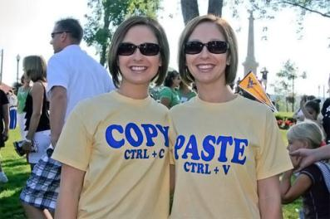
Be Unique
Good presentation
Don't copy paste
What the employer wants?
The point of the CV
Why do you apply?
Be unique
Success Strategy

Slide 35

Be Unique
Good presentation
Don't copy paste
What the employer wants?
The point of the CV
Why do you apply?
Be unique
Success Strategy
Show creativeness

Slide 36

Be Unique
Good presentation
Don't copy paste
What the employer wants?
The point of the CV
Why do you apply?
Be unique
Success Strategy
Show creativeness
Show what you want to show

Slide 37
Why Do You Apply?
Good presentation
What the employer wants?
The point of the CV
Why do you apply?
Be unique
Success Strategy

Slide 38

Why Do You Apply?
Good presentation
What the employer wants?
The point of the CV
Why do you apply?
Be unique
Success Strategy
Why you choose this exact job offer?

Slide 39


Why Do You Apply?
Good presentation
What the employer wants?
The point of the CV
Why do you apply?
Be unique
Success Strategy
Why you choose this exact job offer?
How you plan to develop yourself in the future?

Slide 40
The Point of The Resume
Good presentation
What the employer wants?
The point of the CV
Why do you apply?
Be unique
Success Strategy

Slide 41

The Point of The Resume
Good presentation
What the employer wants?
The point of the CV
Why do you apply?
Be unique
Success Strategy
Who will read it?

Slide 42

The Point of The Resume
Good presentation
What the employer wants?
The point of the CV
Why do you apply?
Be unique
Success Strategy
Who will read it?
The reason you are writing it?

Slide 43

The Point of The Resume
Good presentation
What the employer wants?
The point of the CV
Why do you apply?
Be unique
Success Strategy
Who will read it?
The reason you are writing it?
What is the position you are applying for?

Slide 44
What the Employer Wants?
Good presentation
What the employer wants?
The point of the CV
Why do you apply?
Be unique
Success Strategy

Slide 45

What the Employer Wants?
Good presentation
What the employer wants?
The point of the CV
Why do you apply?
Be unique
Success Strategy
Highlight the relevant things

Slide 46

What the Employer Wants?
Good presentation
What the employer wants?
The point of the CV
Why do you apply?
Be unique
Success Strategy
Highlight the relevant things
Show what the
employer wants to see
Not all you have done
Or just what you have been paid for

Slide 47
Good Presentation
Good presentation
What the employer wants?
The point of the CV
Why do you apply
Be unique
Success Strategy

Slide 48

Good Presentation
Be consistent
Good presentation
What the employer wants?
The point of the CV
Why do you apply
Be unique
Success Strategy

Slide 49

Good Presentation
Be consistent
Good presentation
What the employer wants?
The point of the CV
Why do you apply
Be unique
Success Strategy
Be brief

Slide 50

Good Presentation
Be consistent
Good presentation
What the employer wants?
The point of the CV
Why do you apply
Be unique
Success Strategy
Be brief
Be Focused

Slide 51

How to Stand Out?
Make your CV remarkable!

Slide 52

Structure Your Resume
There are some must-have sections in your CV
Personal information
Objective
Previous work experience
Projects developed
E.g. at the university / high school / etc.
Education
Skills and abilities
Other experience, e.g. at the university
Resume

Slide 53
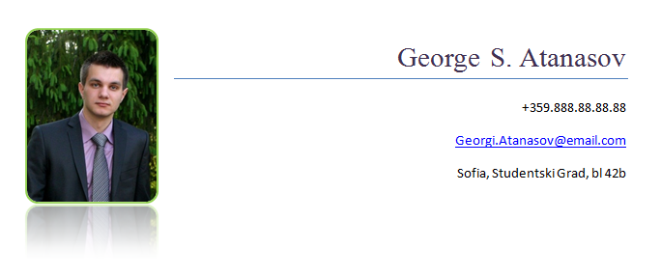
Personal Information
Always you personal info put it at the top
Include the following
Your name
A photo
Your contacts
Email address
Telephone number
Home address
Personal Info

Slide 54

The Photo
Use a personable photo
Photo

Slide 55

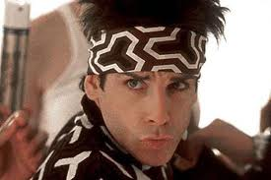
Use a personable photo
The Photo
Don't use Facebook / party / beach photos!
Better no photo at all

Slide 56


Your Contacts
Use your personal contacts
Personal email, personal telephone!
Never use work contacts!
Be sure to have a good-looking email address
Even if you use it only for job applications
PeterPetrov@gmail.com, Nevena.Stoyanova@mail.ru, Asen_Georgiev@yahoo.com, steve@developer.com
Ugly emails to avoid:
DestructorMachine@abv.bg, P373rP37r0v@abv.bg, motherfucker@youporn.net, super.pich.92@gmail.com

Slide 57

Objective
The objective should come after the personal information
What you are applying for?
Be descriptive, but be brief
Don't be overdescriptive
Objective

Slide 58
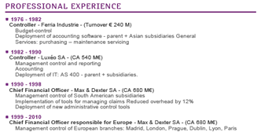
Work Experience
Describe your relevant work experience
Order positions by date (from the last)
Explain your duties at this position
For software developers:
Include the technologies you have used (keywords from the job description)
Irrelevant experience is not important
Skip it unless you don’t have anything else
Experience

Slide 59

Projects Developed
The best way to show expertise is to show something real
Like projects you have developed
Better impression than just plain words like "I am good at…"
No projects?
Why not start a project to gain some experience?
Create a GitHub profile
It is your developer portfolio!
Projects

Slide 60

Education
Describe your formal + informal education
Universities / degrees
High school
Courses taken relevant to the job offer
Add relevant informal education
E.g. @ Software University, @ Coursera, @ Telerik Academy, @ Codecademy, …
Education

Slide 61
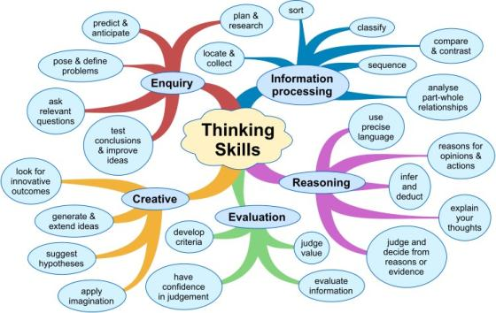
Skills and Abilities
Write down all your skills and abilities
All of them are important
But some are more important than others
Highlight the skills that are most relevant to the current job description
Just mention the others
E.g. software development, unit testing, UI design and source control systems
Not cooking and skiing
Skills

Slide 62

Other Experience / Awards / Certificates
Have any other experience relevant to the job offer?
Describe it!
E.g. participation in the local PHP community
Awards / certificates
List your certificates
E.g. TOEFL, SQL Server, HTML5, …
List your awards
E.g. from contests / Olympiads / hackatons
Experience

Slide 63










Writing a CV
https://softuni.bg/courses/teamwork-and-personal-skills/

Slide 64
License
This course (slides, examples, demos, videos, homework, etc.) is licensed under the "Creative Commons Attribution-NonCommercial-ShareAlike 4.0 International" license

Slide 65






Free Trainings @ Software University
Software University Foundation – softuni.org
Software University – High-Quality Education, Profession and Job for Software Developers
softuni.bg
Software University @ Facebook
facebook.com/SoftwareUniversity
Software University @ YouTube
youtube.com/SoftwareUniversity
Software University Forums – forum.softuni.bg

